Slide 1



& Palliative Care
Francisco Alvarez
CCG Community Pharmacy Lead
Isle of Wight
Notes:
Patient pathway – ask questions as we go along
All information is within the service guide
It is hoped that this service changes patient behaviours, educating and assisting patients in how to access self-care and the appropriate use of healthcare services.

Slide 2
Minor Ailments Service
Pharmacy First
Introduced on the Isle of Wight Summer 2014
Allows supply of medicines at participating pharmacies to treat minor ailments
Medicines supply is free of charge to eligible patients
All service provisions carried out by a pharmacist in private consultation room
Patients will be referred if necessary

Slide 3
Minor Ailments Facts
Research shows high volumes of GP consultations for minor ailments and the associated significant costs these have to the NHS:
  57m consultations involving minor ailments;
  6m consultations involving a minor ailment plus other condition
  51.4m consultations involving minor ailments alone
  18% of GP workload is accounted for by minor ailments alone
  Nearly half the consultations are by 16 - 59 year olds

Slide 4
Minor Ailments Facts
Treatment of minor ailments incurs significant cost to the NHS of £2b
80% of costs are for GPs’ time equating to £1.5b
On average over an hour a day is spent dealing with minor ailments by every GP
Over 91% of all minor ailment consultations result in a prescription at a cost of £371m
What's the bottom line?
The NHS cannot afford to spend £2bn on minor ailments with expensive doctors dealing with conditions that people can cope with themselves and are already doing so

Slide 5
Minor Ailments Services
NHS England report on urgent care review – 2013
“Community pharmacy services can play an important role in enabling self-care, particularly amongst patients with minor ailments and long term conditions”

Slide 6
Patient Eligibility
Eligible patients must be:
  Registered with an Isle of Wight GP
  Present in the pharmacy except children (for child under 16, the parent or guardian must also be in attendance)
  Exempt from prescription charges
  Currently suffering from a minor ailment which is included in the service
  Agree to sharing details of the consultation with their registered GP

Slide 7
Not Eligible
Patients not registered with an IoW GP
Patients who pay prescription charges
Minors who do not attend with parent/Guardian
Patients not willing or who are unable to give consent to share their details – these patients can be offered OTC advice / sale or signposted to their GP surgery.

Slide 8
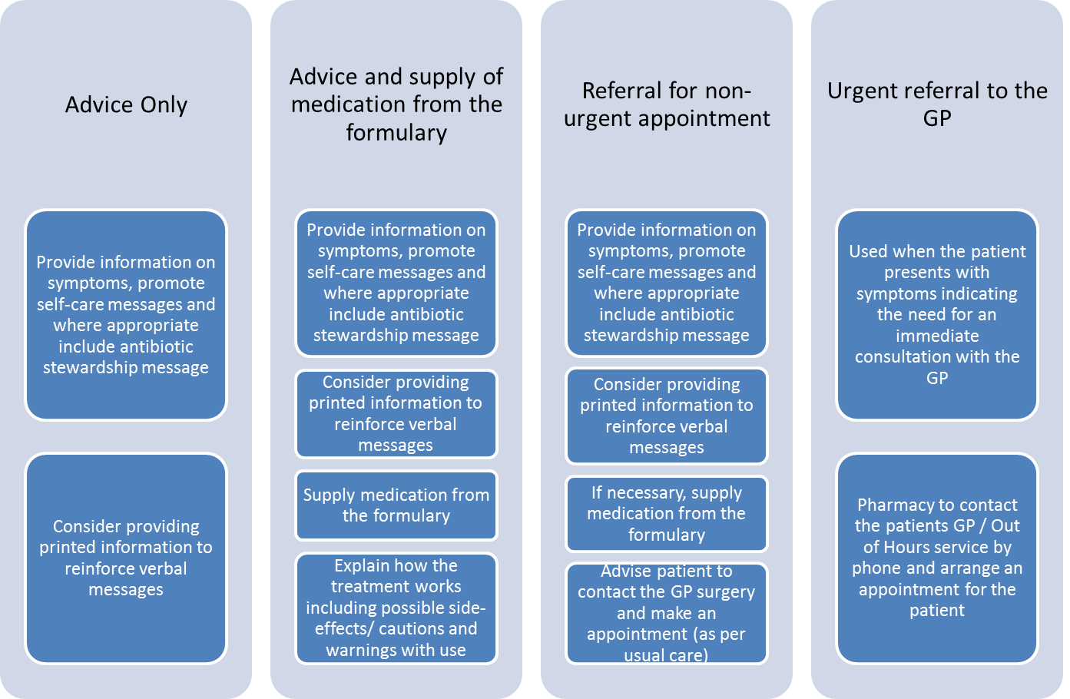
How does the service work?
Notes:
Management options
Cover in more detail over the next few slides

Slide 9
Advice
This is the key element of the service
  Symptoms
  Self-care messages
  Antibiotic advice message
Aim to influence behaviour change
Challenge perceptions that need to visit a GP
Notes:
Behaviour Change
Symptoms
Expected symptoms
What’s normal
Probable duration of symptoms
Self-care messages
What patients can do for themselves to help manage the minor ailment
Dispel any misconceptions the patient may have about visiting GP/OOH e.g. The medication a GP can supply is likely to be the sae
Where (and when) to go for further advice / treatment if necessary e.g. If the cough lasts for more than 3 weeks visit your GP
Management of future minor ailments
Antibiotic stewardship message
Discuss with the patient the key messages about antibiotics not being required for viral infections the usual cause of coughs, colds, earache, sinusitis, flu and sore throat
Highlight the potential harms of taking antibiotics such as:
Side-effects are common and include diarrhoea, rashes and nausea
Potential allergic reactions are possible
Antibiotics can kill off normal 'defence' bacteria which live in the bowel and vagina. This may then allow other infections - for example, thrush - to develop
Some antibiotics can cause you to be sick if you also drink alcohol and some cause reactions to sunlight

Slide 10
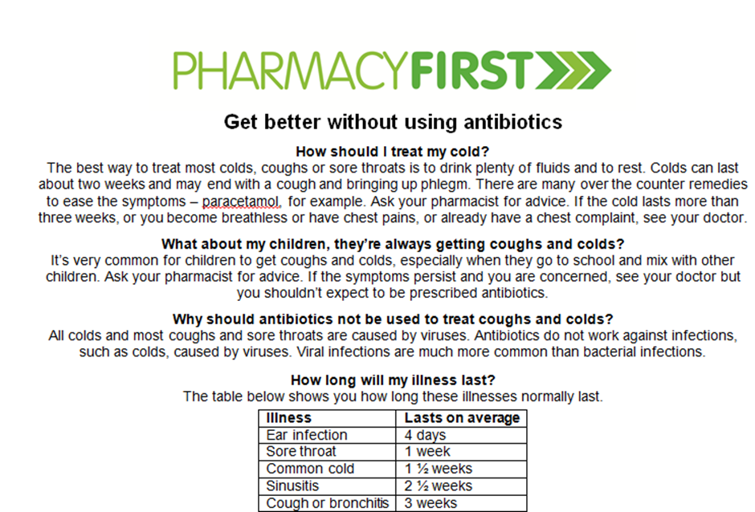
Antibiotic Information
Notes:
Highlight the possible negative effects of antibiotics on the individual as well as the problem with resistance
Greater good message doesn’t work well in changing individual behaviours

Slide 11
Conditions & treatments
Treatable conditions under the minor ailment's scheme
Constipation | Headlice | Dyspepsia
Insect bites & stings | Diarrhoea | Mouth ulcers
Haemorrhoids | Nappy rash | Allergic Rhinitis/Hayfever
Vaginal thrush | Oral thrush adult/paed’ | Sore throat
Minor burns & Scalds Contact dermatitis | Viral upper respiratory tract infection (cough, colds, congestion etc) | Conjunctivitis Paed fever
Headache Cystitis | Earwax Atheletes foot | Musculoskeletal pain & soft tissue injury
Paed teething | Migraleve | Threadworm
Cold sores | Sumatriptan Buccastem | Permethrine cream 5% Salatac gel 8g
Fungal skin infection | Driclor 20mls | Acnecide 30g

Slide 12
Referral – Two different types
Non-urgent
Urgent
Advise the patient and signpost the patient to their GP
The pharmacy should not contact the GP surgery or arrange an appointment for the patient
Usual care
Same day appointment deemed necessary by the pharmacist
Active referral to
  GP practice
  Beacon walk-in centre
  NHS 111
  A+E
Pharmacy to arrange appointment
Ensure that patient gets medical attention at the right time
Part of service
Notes:
The pharmacist should use their clinical judgement to decide the urgency, route and need for referral as ultimately the pharmacist is professionally accountable for their actions.
When referring patients to their GP practice, pharmacists should not give patients the expectation of any specific treatment i.e. antibiotics or length of time until patients can expect GP appointment (unless booked directly by pharmacy as part of the urgent referral process).
The appointment must be deemed necessary by the pharmacist, not the patient.
If a patient feels that they require an appointment, but the pharmacist does not agree, the patient should be directed to contact the GP surgery themselves.
If a patient presents more than twice within any month with the same symptoms but there are no indications for urgent referral, the pharmacist should consider referring the patient to their GP.
Non-urgent = usual care

Slide 13
How can I identify participating pharmacies
Poster
Window stickers
Cards
Notes:
Relationship with GP practice

Slide 14
Pharmacy First - Part 2 - Medicines supply from 01.02.2017 to 22.03.2018 28 out of 31
Notes:
Relationship with GP practice

Slide 15
Pharmacy First - Part 2 - Medicines supply from 2017-02-01 to 2018-03-22
Notes:
Relationship with GP practice

Slide 16
Pharmacy First - Part 2 - Medicines supply from 2017-02-01 to 2018-03-22
Notes:
Relationship with GP practice

Slide 17
A key factor that has had a negative impact on palliative care patients and their families is poor access to appropriate medication, particularly, in relation to the management of pain.
This service helps improve access to palliative care drugs during pharmacy opening hours.
Palliative Care/ Just in Case Drugs

Slide 18
Any questions?
List A, frequently used items
– all pharmacies can participate
Preparation | Category | Stock
Cyclizine (50mg/1ml) Ampoules | POM | 10 amps
Dexamethasone (3.3mg/1ml) Ampoules | POM | 10 amps
Fentanyl (100 micrograms/2ml) Ampoules | CD2 | 10 amps
Haloperidol 5mg/1ml Ampoules | POM | 10 amps
Hyoscine butylbromide 20mg/1ml Ampoules | POM | 10 amps
Levomepromazine (25mg/1ml) Ampoules | POM | 10 amps
Lorazepam 1mg tablets (Genus brand – Those disperse more quickly) | POM | 28 tablets
Metoclopramine (10mg/2ml) Ampoules | POM | 10 amps
Midazolam (10mg/2ml) Ampoules | CD3 | 10 amps
Morphine Sulphate (10mg/1ml) Ampoules | CD2 | 10 amps
Morphine Sulphate (30mg/1ml) Ampoules | CD2 | 10 amps
Oramorph 10mg/5ml Oral Solution (one 300ml bottle) | CD2 | 1X300ml
Oramorph Concentrate 20mg/5ml Sugar Free Oral Solution | CD2 | 1X120ml
Oxycodone (10mg/1ml) Ampoules | CD2 | 10 amps
Water for Injections 20ml size Ampoules | POM | 10 amps

Slide 19
List B, infrequently used items
- agreed small number of pharmacies
Preparation | Category | Stock
Methadone (10mg/1ml) Ampoules for injection | CD2 | 10amps
Ondansetron (4mg/2ml) Ampoules for injection | POM | 5amps
Phenobarbitol (200mg/1ml) Ampoules for injection | CD2 | 10amps
Ranitidine (50mg/2ml) Ampoules for injection | POM | 5amps

Slide 20
List A & B service agreement
A one off participation payment fee to meet the initial set up costs of £100 plus drug costs of £148.05 for list A and £98.11 for list B (if required).
A further, quarterly payment of £60 will be paid to each pharmacy participating in the service to include the cost of providing the quarterly audit and review of service.
Payment for audit will be made following submission of a completed quarterly audit on PharmOutcomes relevant to the service provided by the pharmacy contractor.
Payment will be made within 30 days from the end of the calendar month in which the claim is received.

Slide 21
Patient Consultation from 01.02.2017 to 22.03.2018 3 out 31

Slide 22
Any Question?
Francisco Alvarez
Community Pharmacy Lead
Isle of Wight
francisco.alvarez@nhs.net

