Slide 1
Electronic Repeat Dispensing (eRD)
Gary Mortimer
gmortimer@nhs.net
Implementation and Business Change

Slide 2
EPS Release 2 - Recap

Slide 3
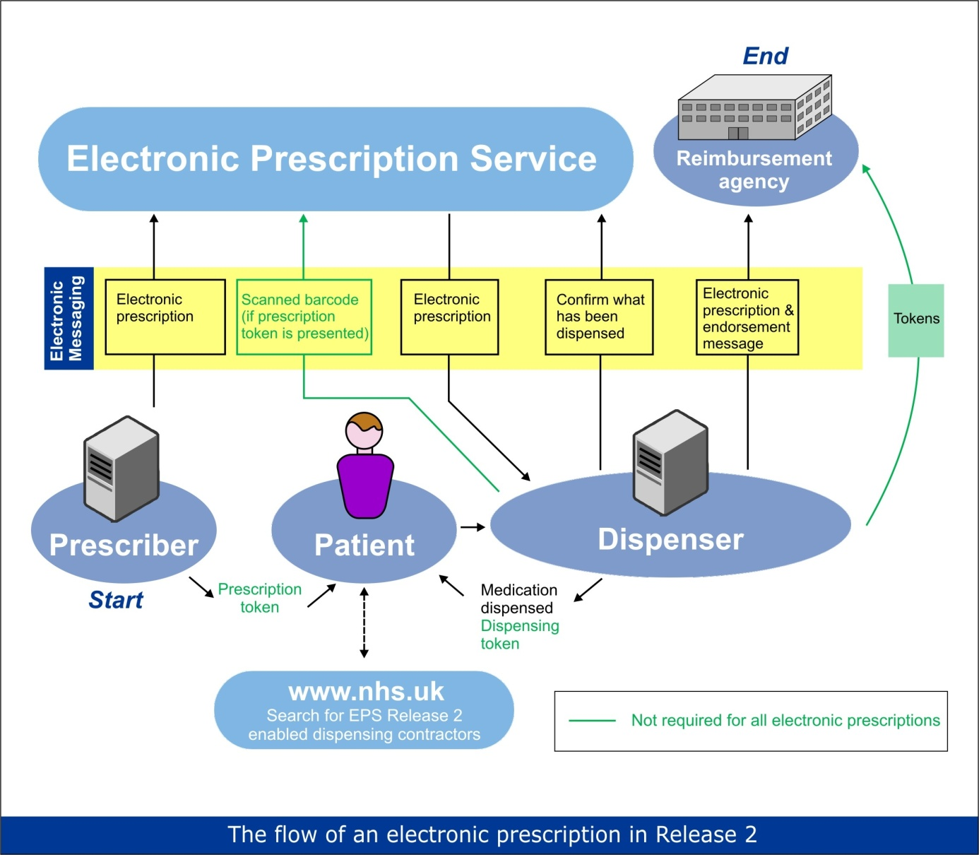

Release 2 Overview
NHS Spine
Notes:
Key points:
- Acute scripts – manual download or tracker (timings)
- Capturing patient nominations
- Cancellation vs Not dispensed.
- No return messaging to Prescriber
- Patient messages –refer to PSNC Website
-

Slide 4

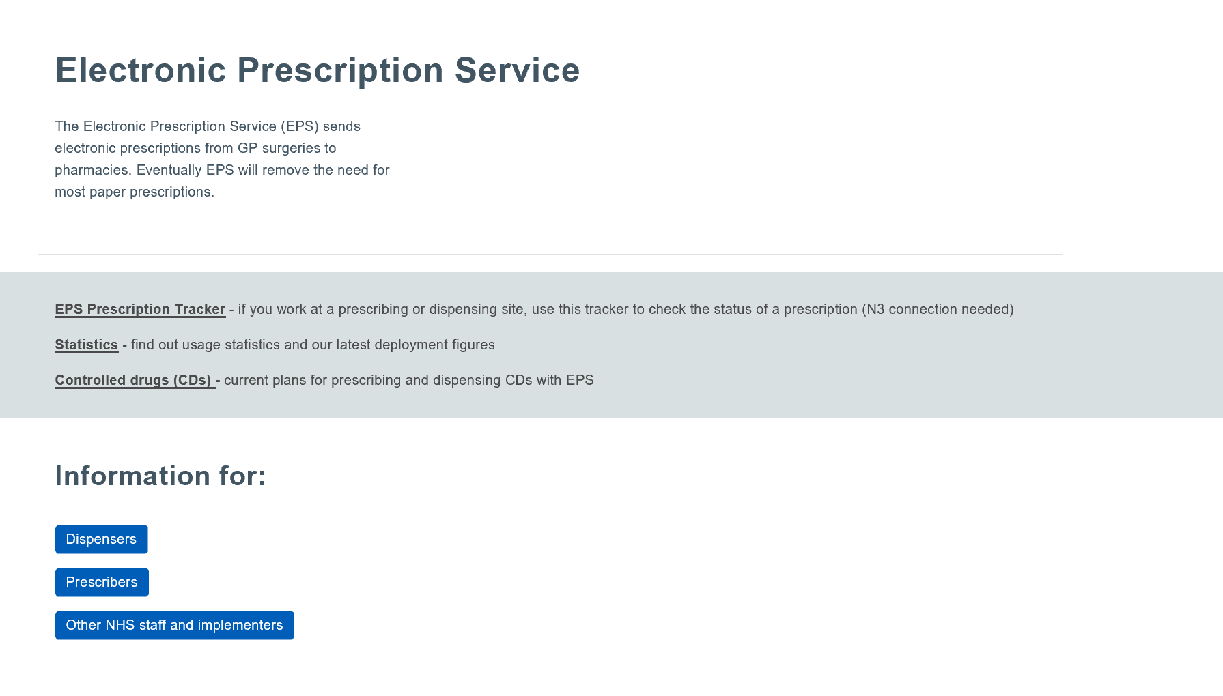
EPS Prescription Tracker
https://digital.nhs.uk/Electronic-Prescription-Service
Notes:
Intro to the EPS tracker

Slide 5
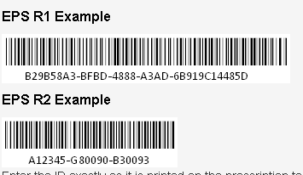
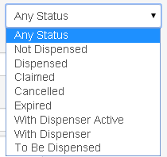
Screen 1
Filter search options: All Rx types, R1 or R2.
Status search options
Search by Patient NHS number
Notes:
New –my site facility. (ODS code) Search for prescriptions related to the organisation for the current logged on user. If a prescribing site, prescriptions authorised by that site will be returned. If a dispensing site, prescriptions nominated, but not yet downloaded to that site, together with prescriptions downloaded, dispensed, or claimed by that site will be returned. Also search for prescriptions from just a particular prescribing site.
Can be used to identify Acute prescriptions.

Slide 6
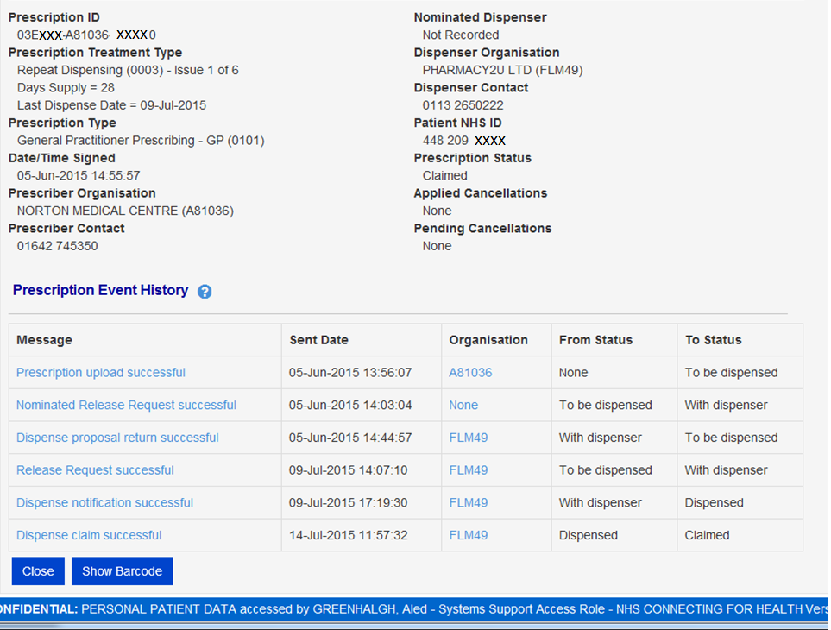
Screen 2 - Prescription and Dispensing Details
Nominated Dispenser details.
Applied or pending cancellation requests – shows whole or part of prescription.
Copy and paste prescription ID or Show Barcode

Slide 7
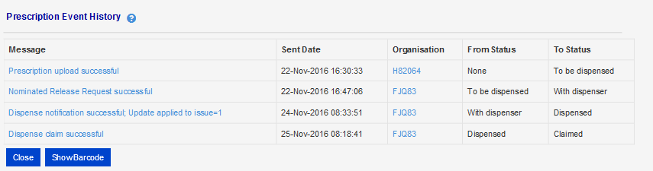
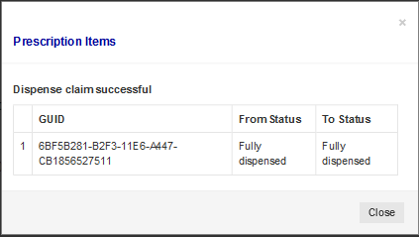
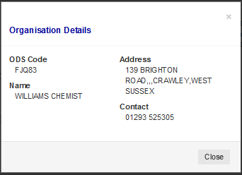
Further details
Notes:
Details item information behind message descriptions

Slide 8
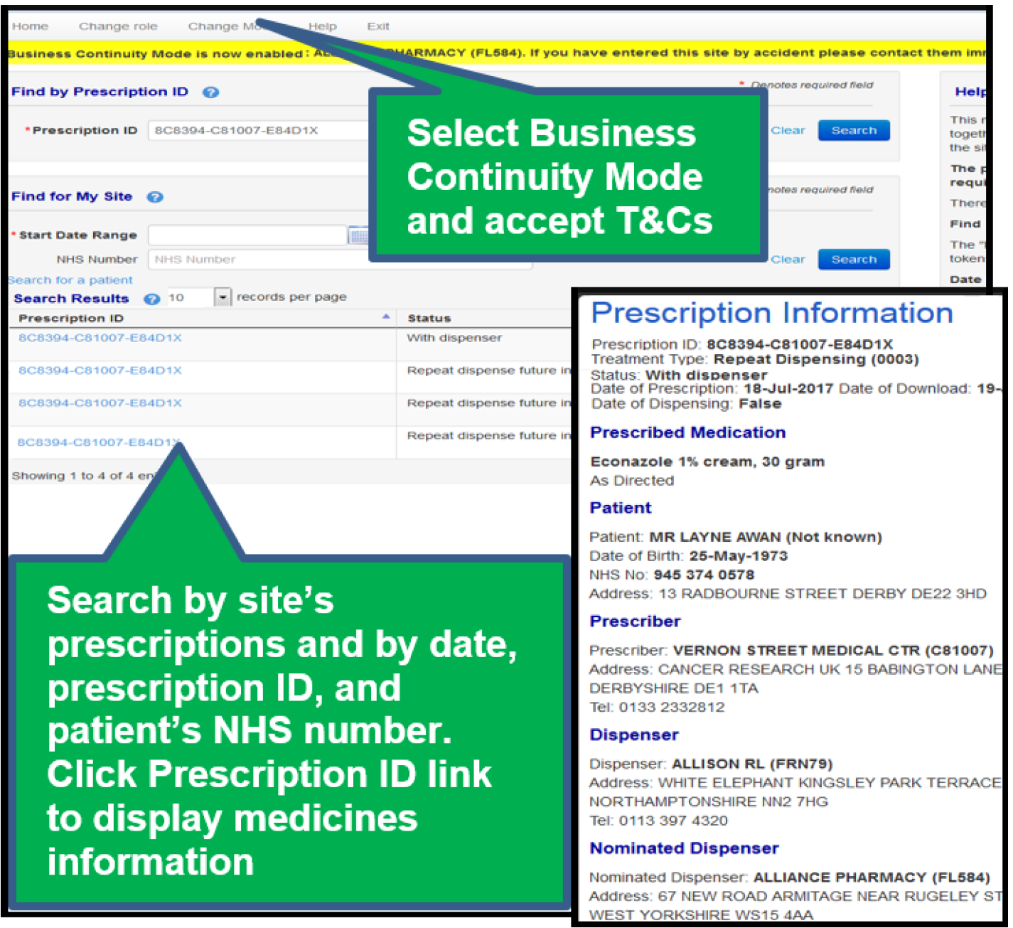
Business continuity mode

Slide 9
How Does eRD process Work?

Slide 10

1
2
3
4
5
6
1 x Passcode

Slide 11
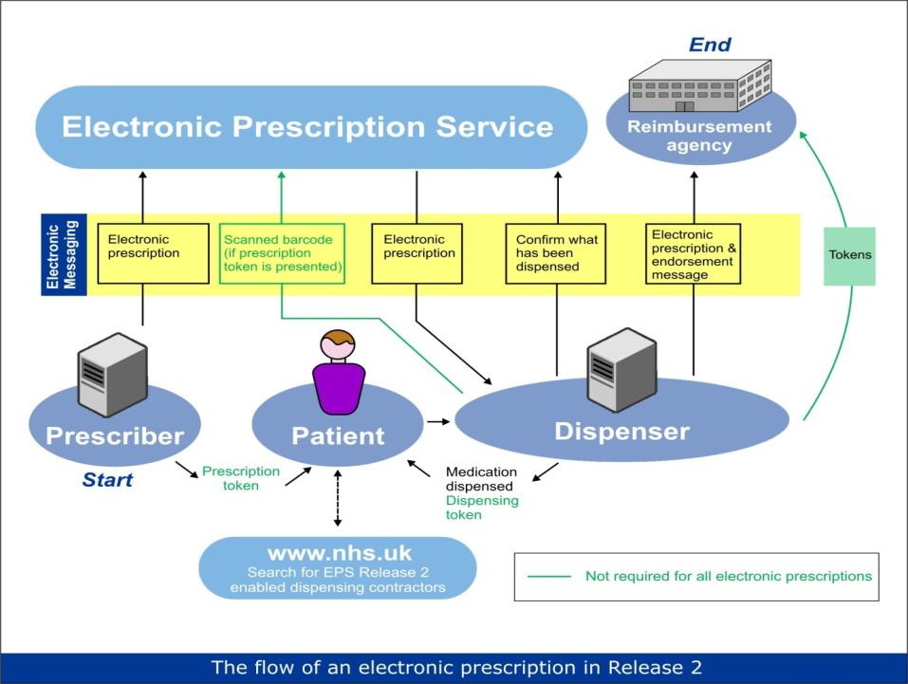
6
5
4
3
2
1
28
28
28
28
28

Slide 12

6
5
4
3
2
1
28
28
28
28
28
?
?
?
?

Slide 13

6
5
4
3
2
23
13
11
9
28
8
28
27
26
25
24
22
21
20
19
18
17
16
15
14
12
10
28
28
28
7
28
Day 1 = Signed date
1

Slide 14
6
5
4
3
2
23
13
11
9
28
8
28
27
26
25
24
22
21
20
19
18
17
16
15
14
12
10
28
28
28
7
28
1
?
?
?
?

Slide 15
6
5
4
3
23
13
11
9
28
8
28
27
26
25
24
22
21
20
19
18
17
16
15
14
12
10
28
28
28
7
28
1
2
?
?
?
?

Slide 16
6
5
4
3
28
28
28
28
1
2

Slide 17
6
5
4
3
28
7
7
28
7
28
28
7
1
2

Slide 18

1
5
6
Review?

Slide 19

6
5
4
3
23
13
11
9
28
8
28
27
26
25
24
22
21
20
19
18
17
16
15
14
12
10
28
28
28
7
28
1
2
Patient requests additional medication because they are going on holiday?

Slide 20
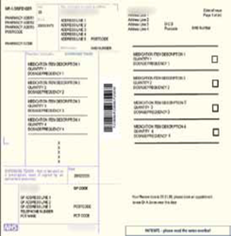
6
5
4
3
23
13
11
9
28
8
28
27
26
25
24
22
21
20
19
18
17
16
15
14
12
10
28
28
28
7
56
28
1
2

Slide 21
6
5
4
23
13
11
9
28
56
8
28
27
26
25
24
22
21
20
19
18
17
16
15
14
12
10
28
7
28
2
3

Slide 22
eRD and the Prescription Tracker

Slide 23
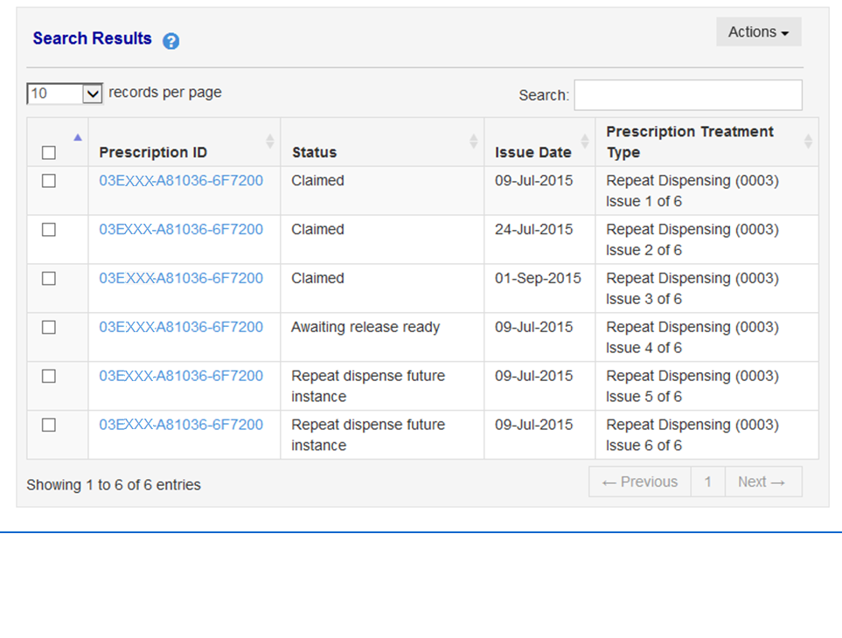
The status of the prescription changes as it passes from Spine to Pharmacy to Patient.
All issues have the same Prescription ID
EPS Prescription Tracker shows each issue individually

Slide 24

Medication changes
Prescription items on the spine can not be amended, it has to be cancelled and re-issued by the GP. The GP’s options include:
Cancel ALL outstanding items on the Spine and replace with a new batch
Cancel individual item(s)
‘Bridge the gap’ with a one-off script – if other medications are running out; generate a one-off script until ready to start a new eRD batch for all items.

Slide 25



6
5
4
3
Cancel Pending for Issue 2
28
28
28
28
With
Patient
1
2

Slide 26


6
5
4
3
Cancel Pending for Issue 2
With
Patient
Cancellation rejection
Prescription is “with dispenser”
1
2

Slide 27
6
5
4
3
With
Patient
1
1
2
3
4
5
1 x Passcode

Slide 28
6
5
4
3
4
3
2
1
With
Patient
5
28
28
28
28
New eRD regimen with new barcode

Slide 29
6
5
4
3
4
3
2
1
With
Patient
5
28
28
28
28
Gap to start of new regime

Slide 30
6
5
4
3
4
3
2
1
With
Patient
5
28
28
28
28
“Bridge the Gap”
nDay?
Acute

Slide 31
6
5
4
3
4
3
2
1
With
Patient
5
28
28
28
28

Slide 32
eRD Resources

Slide 34
EPS data online
https://www.digital.nhs.uk/deployment-and-utilisation-progress-data

Slide 35
eRD Resources
NHS England eRD Guidance
  http://www.england.nhs.uk/ourwork/tsd/sst/erd-guidance
CPPE e-learning
https://www.cppe.ac.uk/programmes/l/repeat-e-01/
EPS utilisation dashboards (power BI tool)
https://www.digital.nhs.uk/deployment-and-utilisation-progress-data
eRD Toolkit for Dispensers
https://www.digital.nhs.uk/Electronic-Prescription-Service/Electronic-repeat-dispensing-for-dispensers
Benefits Estimator
  https://epsestimator.digital.nhs.uk/#!/prescriber
NHS Digital EPS
https://digital.nhs.uk/eps

