Slide 1
Nitrofurantoin and Fusidic Acid
Debbie Cumming

Slide 2
UTI and Impetigo
Gram Positive - outside - can you give me any examples?
Gram Negative – inside – can you give me any examples?
So UTIs mainly caused by… and impetigo by….?

Slide 3
Nitrofurantoin: Inclusion criteria – for Uncomplicated UTI in women - symptoms
Dysuria
Suprapubic pain
Nocturia of recent onset
Increased frequency and urgency of recent onset
…….Smelly urine is not an indication
Notes:
Difficult or painful piddling
Night time piddling… elderly men enlarged prostate…
LUTS lower urinary tract symptoms prostatisim

Slide 4
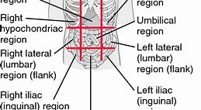
Where is suprapubic?
Where is flank

Slide 5
Nitrofurantoin - Exclusions include:
Immunocompromised
Renal problems
Already on an antibiotic
Pregnancy - (risk of hemolyisis to the baby’s immature red cells)
Pyelonephritis
Porphyria
G6PD deficiency
Vaginal discharge
Notes:
Porphyria 1: 75,000 heriditary haem breakdown - light exposed skin reactions and neuritis
G6PD deficiency CHO metabolism defect infancy low blood sugars enlarged liver
Pyelonephritis the kidney itself

Slide 6
Where is suprapubic?
Where is flank

Slide 7
Cautions:
GFR < 45ml/min
Chronic pulmonary reactions – more common in elderly
Side Effects:
Very common >1/10
Common 1/10 - 1/100
Uncommon 1/100 - 1/1000
Rare 1/1000 - 1/10,000
Very Rare < 1/10,000

Slide 8
Patient Information – really important

Slide 9
How does it work…
Nitrofurantoin is reduced by bacterial flavoproteins to reactive intermediates which inactivate or alter bacterial ribosomal proteins and other macromolecules inc DNA. ...
Nitrofurantoin is bactericidal in urine at therapeutic doses

Slide 10
Effective against susceptible organisms:
E. coli
Klebsiella spp.
S. Saphrophyticus *******
Pseudomonas is resistant
Resistance 2015 was < 5% for both hospital and community urine cultures … whereas for Trimethoprim ???????
Resistance is increasing …. (intrinsic, acquired or thrust upon the organism)
……which has implications…… for that patient and for society…. Safety netting is important…

Slide 11
Impetigo and Fusidic Acid
Superficial bacterial skin infection - pustules and honey-coloured crusted erosions
S. aureus
S. pyogenes
Dermnet NZ – great images

Slide 12
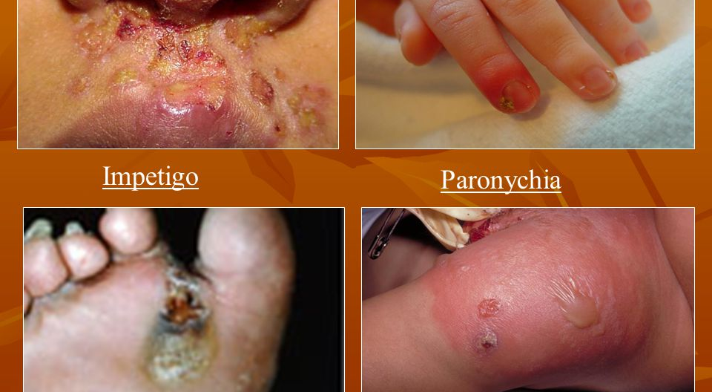
Really good images -
Google Dermnet NZ (these are from Bing images)

Slide 13
Inclusion
Limited to a few lesions in one area of the body
Parental consent if under 16
You must see the patient

Slide 14
Exclusion
Multiple sites or too large an area
Allergy
Pregnancy and breastfeeding ****
Other skin condition at same site (eczema)
N.B. Cellulitis is an infection of the skin that extends into the subcutaneous tissues and can spread and go on to be necrotising fasciitis………

Slide 15
Patient information - really important…

Slide 16
Fusidic Acid: Mechanism of action:
At the ribosome - Blocks protein synthesis by binding to the elongation factor G!!
Bacteriostatic…..
Effective against typical skin organisms: Staph aureus and the coagulase negative Staphs and some Streps
Not effective against Gram Negatives….
Can even work for MRSA but single point mutation will make it resistant…
So NB: If given orally or iv then not used on its own… used in combination…

