Slide 1
Medicines Optimisation
Transfer of Care Around Medicines TCAM
Wessex AHSN
12th September 2017
Clare Howard FFRPS FRPharmS
Clinical Lead
Medicines Optimisation

Slide 2
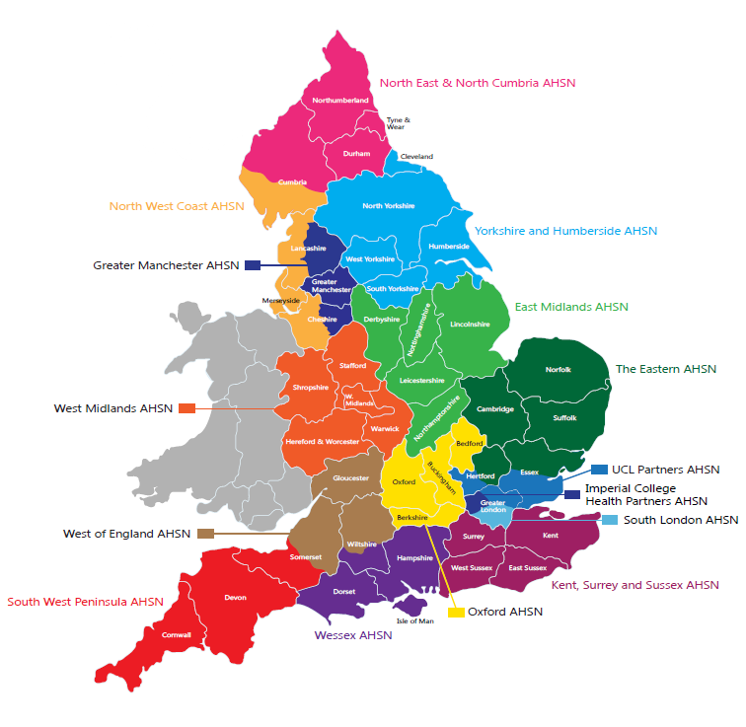
Regionally-based system-wide integrators - Improving the health and wealth of the country
Academic
Academic
Using sound methods
Health
Improving health
Science
Network
Innovation & evidence
Partnerships and collaborations
Notes:
Describe in generic terms what AHSNs are here to do. See blurb from comms team for words:
About AHSNs
As the only bodies that connect NHS and academic organisations, local authorities, the third sector and industry, we are catalysts that create the right conditions to facilitate change across whole health and social care economies, with a clear focus on improving outcomes for patients.
This means we are uniquely placed to identify and spread health innovation at pace and scale; driving the adoption and spread of innovative ideas and technologies across large populations. Although small organisations – which ensures we remain flexible and responsive to emerging opportunities and challenges – we lead large regional networks. Hence our impact rests in our ability to bring people, resources and organisations together quickly, delivering benefits that could not be achieved alone. This Innovation Pathway summarises how AHSNs support the entire innovation life cycle.

Slide 3
The Medicines Pathway
Medicines Use Reviews (MURs) and New Medicines Service (NMS) are under utilized
Those most at risk of medication errors may not be highlighted to Community Pharmacy e.g. those recently discharged from hospital.
It is estimated that 60% of patients have three or more changes made to their medicines during a hospital stay. The transfer of care process is associated with an increased risk of adverse effects (AEDs) (1)
30-70% of patients experience unintentional changes to their treatment or an error is made because of a lack of communication or miscommunication. Only 10% of elderly patients will be discharged on the same medication that they were admitted to hospital on. (2)
and 20% of patients have been reported to experience adverse events within 3 weeks of discharge, 60% of which could have been ameliorated or avoided (3).
Notes:
1)( Himmel W, Kochen MM, Sorns U et al Drug changes at the interface between primary and secondary care. International Journal of Clinical Pharmacology and Therapeutics 2004:42; 103-109)
(2)(Mansur N Weiss A Beloosesky Y. Relationship of in hospital medication modifications of elderly patients to post discharge medication, adherence and mortality Ann Pharmacotherapy 2008; 42: 783-789)
(3) Hesselink G, Schoonhoven L, Barach P, Spijker A, Gademan P; Kalkman C, Liefers J, Vernoonji-Dassen M, Wollersheim H. Improving patient handovers from hospital to primary care; A systematic review. Ann Intrn Med 2012; 157: 417-28).

Slide 4
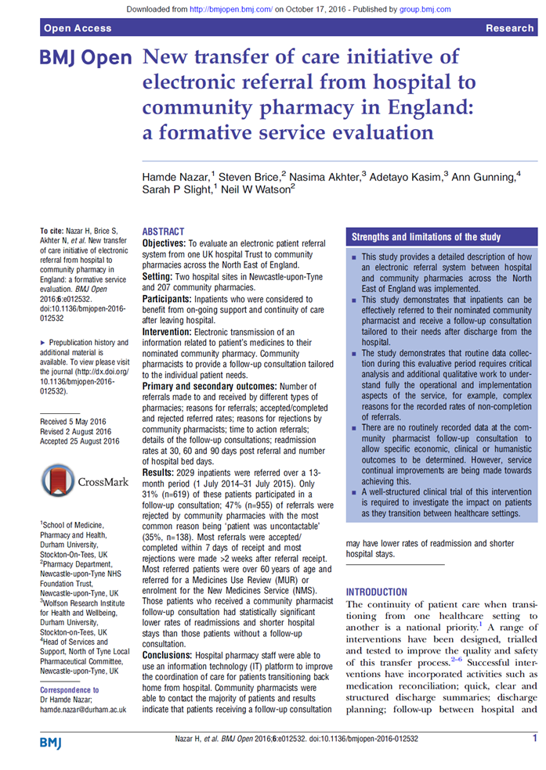
Clinical Handover – Integrated Transfer of Care
Community Pharmacy and Hospital Pharmacy - working together to optimise the use of medicines
New transfer of care initiative of electronic referral from hospital to community pharmacy in England:
a formative service evaluation
Hamde et al. BMJ Open October 2016
“statistically significant lower rates
of readmissions and shorter hospital stays”

Slide 5
Newcastle study…..
Review of first 2,029 in-patients who were referred showed…
Although only 31% (n=619) of these patients participated in a follow-up consultation, those patients who received a community pharmacist follow-up consultation had significantly lower rates of readmissions and shorter hospital stays than those patients without a follow-up consultation. (8)
Notes:
Neil to add ref and build on

Slide 6
Isle of Wight
Review 2 patients to prevent 3 admissions/year
For each patient reviewed avoid 12 bed days/year
For each patient reviewed avoid 4.5 excess bed days/year.
Notes:
Higher risk patients eligible for reablement but received HAO or HAO and CPR. Patients in the CPR group showed fewer admissions

Slide 7
PROGRESS IN ALL AHSN’S
Over the last months of 2016 surveyed all AHSN areas and have picture of activity…
Summary
Wessex, NENC, West of England, East Midlands, Oxford, North West and South West AHSNs all have Trusts in their area with referral pathways fully operational. In addition, they have programmes of work to ensure all (or most) trusts in their area are working to implement clinical handover to community pharmacy.
KSS, Eastern and UCL Partners have planning underway.
London Imperial, Greater Manchester, South London HIN and West Midlands AHSNs are currently at scoping or exploratory stage.
Yorkshire and Humber AHSN has work within their patch but not as an AHSN-led work stream.
Some AHSNs have stated that their programme for roll out is either being led or being supported formally in some way by their LPN.

Slide 8
MYTHS ABOUT THIS SERVICE….
MURs – it will put pressure on the 400 limit.
Takes a long time for Hospital Pharmacists to make the referral.
Community Pharmacists need to record lots of data.
The low up take rate is because community pharmacy is not engaged.
Notes:
In Dorset, the highest performing Pharmacy has received 35 referrals from the hospital in 15 months. Roughly 50% of the referrals result in an NMS not an MUR so Vicki and I have estimated that the burden on MUR activity is just over one per month or a maximum of 20 in a year.
Newcastle Hospital which has over 2 years of experience with electronic discharge to community pharmacy makes 120 - 150 referrals per month across the whole of the North East. I have spoken to North Tyne LPC lead for this project, Ann Gunning and she confirmed that for their Pharmacies, it is about 1 referral per month and they result in either an MUR or an NMS. So she said it had had a relatively small impact on the 400 limit for each individual pharmacy.
We have been advised that the time taken to complete the Pharmoutcomes platform is 2-3 minutes and this was backed up by North Tyne LPC.
In Dorset, the highest performing Pharmacy has received 35 referrals from the hospital in 15 months. Roughly 50% of the referrals result in an NMS not an MUR so Vicki and I have estimated that the burden on MUR activity is just over one per month or a maximum of 20 in a year.
Newcastle Hospital which has over 2 years of experience with electronic discharge to community pharmacy makes 120 - 150 referrals per month across the whole of the North East. I have spoken to North Tyne LPC lead for this project, Ann Gunning and she confirmed that for their Pharmacies, it is about 1 referral per month and they result in either an MUR or an NMS. So she said it had had a relatively small impact on the 400 limit for each individual pharmacy.
We have been advised that the time taken to complete the Pharmoutcomes platform is 2-3 minutes and this was backed up by North Tyne LPC.

Slide 9
OUTCOMES OF REFERRALS FROM DORSET COUNTY HOSPITAL
Service provided | Number
MUR | 292
NMS | 244
Home delivery | 140
Medidose | 80
Repeat dispensing | 53
Medicine reconciliation | 28
Smoking cessation | 25
Discussion | 23
Review of dosage form | 17
Review MDS arrangements | 13
Flu vaccination | 12
MAR chart | 7
Large print labels | 7
Easy open tops | 6
Healthy living advice | 6
Appliance Use Review | 1

Slide 10
WHY IS THIS IMPORTANT LOCALLY?
Firstly – This service has been shown to positively impact upon patient care.
Secondly - this is about the pharmacy profession joining forces along the medicines pathway to support patients to help them to stay out of hospital.
James Allen will spell out the benefits for the local economy but it is important that the STP see the benefit of community pharmacy involvement in the medicines pathway.
Some think that Community Pharmacy won’t deliver. We should prove otherwise.
Need to cement a system that already has community pharmacy delivering services that help stop avoidable admissions.
Notes:
References:
3. HSCIC, Prescriptions dispensed in the community, England 2003-13, July 2014 (http://www.hscic.gov.uk/catalogue/PUB14414/pres-disp-com-eng-2003-13-rep.pdf)
4. NHS Choices, Prescriptions '1 in 20 has an error', 2012 (http://www.nhs.uk/news/2012/05may/Pages/gmc-medication-prescribing-errors-report.aspx)
5. University of Nottingham, Prescribing Safety and Overview of PINCER, September 2014 (https://www.nottingham.ac.uk/primis/documents/pptsforum2014/prescribingsafetypincertonyaverysarahrodgers.pdf
https://www.frontier-economics.com/documents/2014/10/exploring-the-costs-of-unsafe-care-in-the-nhs-frontier-report-2-2-2-2.pdf

