Slide 1

Electronic Repeat Dispensing (eRD) in response to Covid 19
NOTE: This is not a training resource for eRD, it provides an outline explanation of the NHS response needed for eRD during the Covid 19 crisis and support for primary care to deliver that response.
March 2020

Slide 2
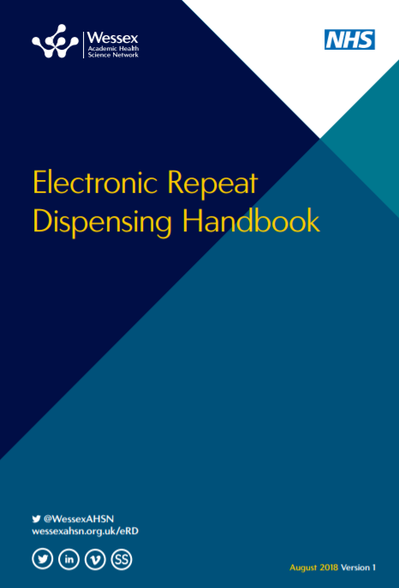
Contents
1 | Background
2 | Benefits (in response to Covid 19)
3 | eRD levels in England
4 | Support
5 | Resources

Slide 3
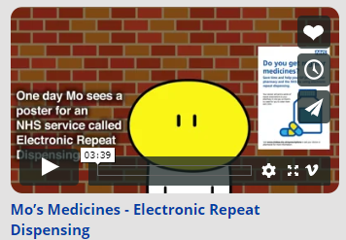
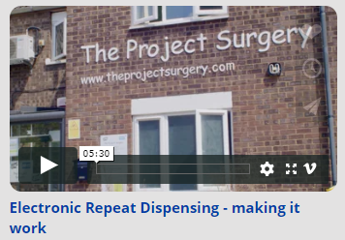
1. Background – eRD
eRD is not new, it has been part of the Community Pharmacy contract since 2005 and from 2019 has been a GMS contract requirement.
eRD has a number of well documented benefits for primary care. However, uptake of eRD is hugely variable – see slides 5,6 and 7
77% of all prescription items are repeat prescriptions.
On average, each week, a GP issues around 375 repeat medicines.
Department of Health work in 2002 showed that, if 80% of all repeats were given as RD, 2.7 million GP hours would be saved.
For example, in Wessex this means that if we moved 80% of all repeats to eRD we would save 108,000 GP hours, which is roughly 61 WTE GPs.

Slide 4
2. Benefits of eRD in response to Covid 19
As part of the Primary Care response to Covid 19, NHS England have stated: "General practices have been asked to consider putting all suitable patients on electronic repeat dispensing as their next repeat prescriptions are issued. The whole repeatable prescription can be valid for a year, but each repeat should be for no longer than the patient has now. For example, if the patient has prescriptions for a month’s supply now, then the repeat dispensing should be set up as 13 x 28 days supply.”
Increasing eRD will have the following benefits in the current situation:
Reducing footfall to the GP practice and to the community pharmacy, supporting social distancing.
Reducing workload for prescribers allowing better prioritisation of resources
Controlled management of the supply chain reducing the number of temporarily unavailable medicines.
Where eRD has been championed for repeat prescribing, practices have successfully achieved over 70% of patients receiving their medications in this way.
Early findings from a qualitative study in Wessex also indicate that patient experience with eRD is a good one.
Notes:
Patient eRD experiences study
Early findings from a small study with patients who use eRD (7 questionnaires, 5 telephone interviews), show that whilst 43% reported challenges in using eRD, the majority (72%), reported it to be helpful, with all stating that they would recommend eRD to their family and friends. For example, *Betty explains how she has found eRD helpful:
“Due to many problems with the buses, plus difficulties obtaining doctors appointments I find it helpful. Plus I find it saves my GP work and while I can collect prescriptions in person at the Pharmacy, thus saving the delivery service time, effort and expense, hopefully helping the NHS, too”
Brooks, C. F. (Study Lead), Matheson-Monnet, C. B., & Argyropoulos, A. Exploring the eRD experiences and views of patients study, Centre for Implementation Science and Innovation Insight, University of Southampton and Wessex AHSN
Contact: Cindy Brooks, C.F.Brooks@soton.ac.uk

Slide 5
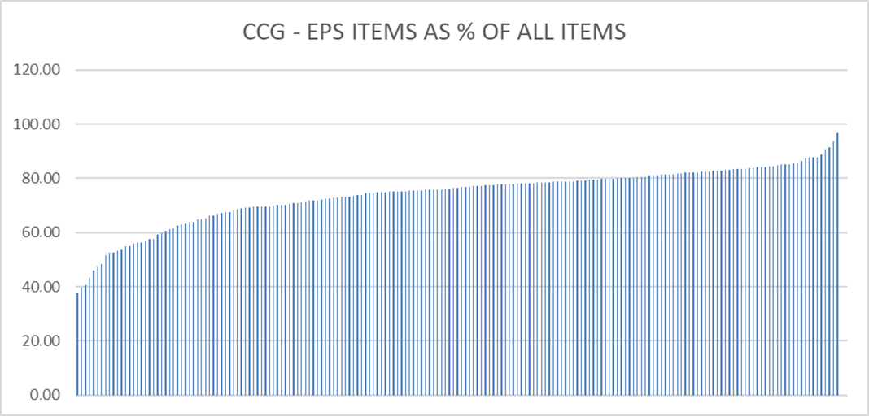
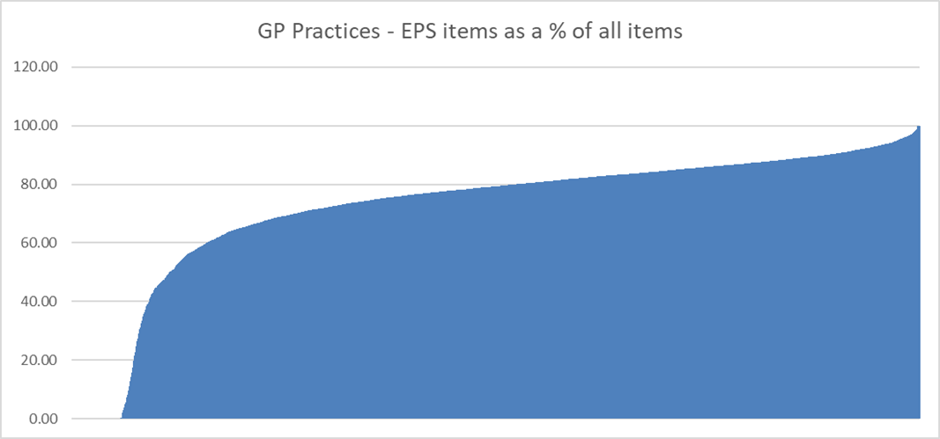
3. EPS - Variation across the country
As at Dec 19
135 of 191 CCGs are below 80% EPS utilisation
Range of EPS use across CCGs was 37.74% to 96.61%
As at Dec 19
393 GP practices were not using EPS
But highest utilisation was 100%

Slide 6
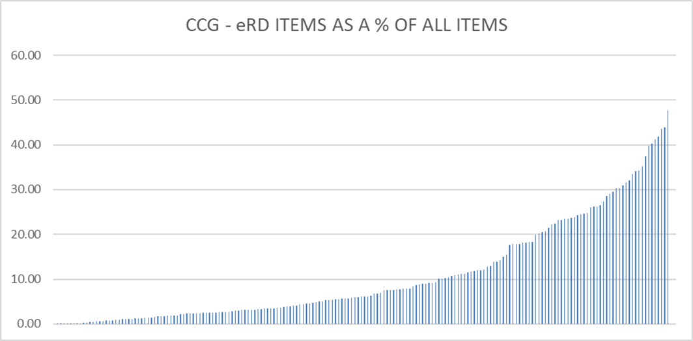
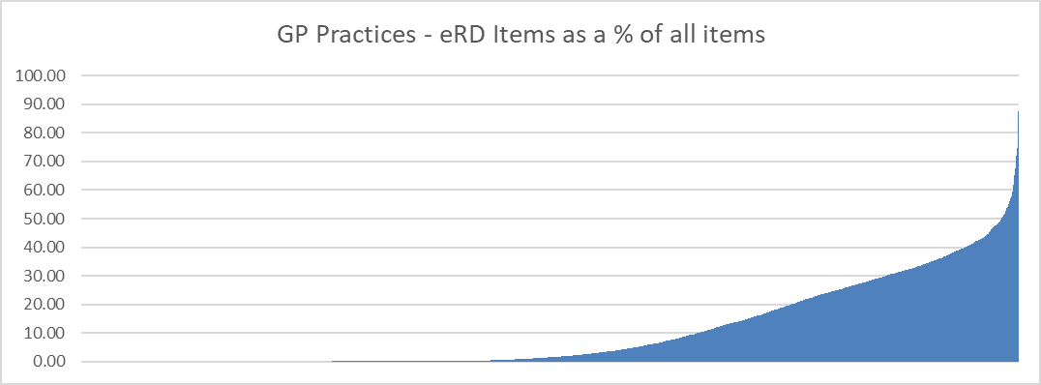
3. eRD – Variation across the country
As at Dec 19
CCGs use of eRD ranged from 0% to 47.7%
As at Dec 19
1834 GP Practices had zero eRD utilisation
Highest utilisation was 87.5%

Slide 7
3. eRD by AHSN
(note within this there will be significant variation at CCG and Practice level)

Slide 8
4. Support for GP practices and Community Pharmacies
There are a range of resources already available to support implementation See slide 13 . No one should need to write further guidance on eRD.
Identification of suitable patients - NHS BSA now have the ability to support GP practices by providing them with the NHS numbers of patients who have had the same medicines dispensed to them for the last 12 months.
This will be released to practices in stages and the following slides describe the process that the NHS BSA will use.
NHS BSA are able to provide further support and signposting to practices that contact them.
CCGs embarking on moving patients to eRD MUST discuss plans with their Local Pharmaceutical Committee (LPC) prior to switching.
Practices moving to eRD must discuss their plans with local community pharmacies.

Slide 9
NHS BSA Process to provide GP Practices with NHS numbers of patients suitable for electronic repeat dispensing
To help support the response to Covid-19, NHS Business Services Authority (NHSBSA) will introduce a new streamlined service for GP practices to receive NHS Numbers for patients who may be eligible for Electronic Repeat Dispensing (eRD).
NHSBSA will contact every GP practice for whom we have contact details, to confirm whether they have an active nhs.net email address. NHSBSA will only send NHS numbers to nhs.net email addresses.
Once confirmed, NHSBSA will send the practice an email with a file containing the following information for patients within the criteria specified on slide 12 that are potentially eligible for eRD:
  NHS Number
  Name of item prescribed (dm+d, Virtual Medicinal Product and described generically )
Once the practice has received the NHS Numbers, a clinician should review the patient records of those patients to ensure that they are appropriate for eRD.
The practice should then arrange for verified patients to be moved to eRD.
  NHSBSA can provide materials and guidance to support moving appropriate patients to eRD.
  NB This will only include EPS prescriptions

Slide 10
How are patients identified for eRD?
NHSBSA will apply the following criteria to identify which patients may be eligible for eRD
Patient identifier | Description
Patients on single medication for last 12 months | Patients on a single unchanged medication for last 12 months on EPS
Patients on two medications for the last 12 months | Patients have been included on the basis that they have received at least 12 prescriptions for the same two medications, in the 12 month period specified. Patients may have received more than one prescription in any given month, so there may be gaps in any individual patient's prescribing history.
Patients on three medications for the last 12 months | Patients have been included on the basis that they have received at least 12 prescriptions for the same three medications, in the 12 month period specified. Patients may have received more than one prescription in any given month, so there may be gaps in any individual patient's prescribing history.
Data currently excludes:
patients aged 18 or under
  Appliances
  Personally administered drugs and medicines (PADMs)
  Dispensing Doctors
  Controlled Drugs
  FP10 MDA

Slide 11
NHSBSA contacts all GP practices (where email addresses are available)
NHS BSA Process to provide GP Practices with NHS numbers of patients suitable for electronic repeat dispensing
NHSBSA send the GP practice NHS Numbers for patients who are potentially eligible for eRD.
Yes
Does the practice respond to confirm email address?
Does practice have prior experience of eRD or EPS levels of above 60%?
NHSBSA review EPS and eRD data for the practice
Yes
NHSBSA provides NHS numbers to the practice.
Also provides additional advice and guidance around what is required to implement eRD effectively.
No
End
No
Key Points
All NHS Numbers must be clinically reviewed to ensure that it is clinically appropriate for that patient to move to eRD.
It is vital for the medicines supply chain that the duration of each eRD prescription remains the same as prior to moving to eRD (e.g. 28 or 56 days supply maximum)
NHSBSA will provide any GP practice with NHS numbers for patients who may be eligible for eRD.
Additional support and guidance is available from NHSBSA to GP practices with low EPS utilisation or no experience of eRD.

Slide 12

5. Resources https://wessexahsn.org.uk/projects/120/electronic-repeat-dispensing)
1. Technical resources
  eRD Handbook
  https://wessexahsn.org.uk/img/projects/Electronic%20Dispensing%20Handbook_Digital_WEB_S.pdf
  NHS BSA Resources
  https://www.nhsbsa.nhs.uk/pharmacies-gp-practices-and-appliance-contractors/prescribing-and-dispensing/electronic/electronic
  NECS eRD e learning tool
  https://learning.necsu.nhs.uk/nhs-digital-electronic-repeat-dispensing-elearning/
2. Patient communications
  Meet Mo video
  https://wessexahsn.org.uk/videos/show/255
  eRD information leaflets
  https://www.nhsbsa.nhs.uk/sites/default/files/2019-11/eRD%20leaflet%20A5%20%28V3%29%20%28Local%29%2012.2018.pdf

Slide 13


Electronic Repeat Dispensing (eRD)
Medicines Optimisation

